Slide 1
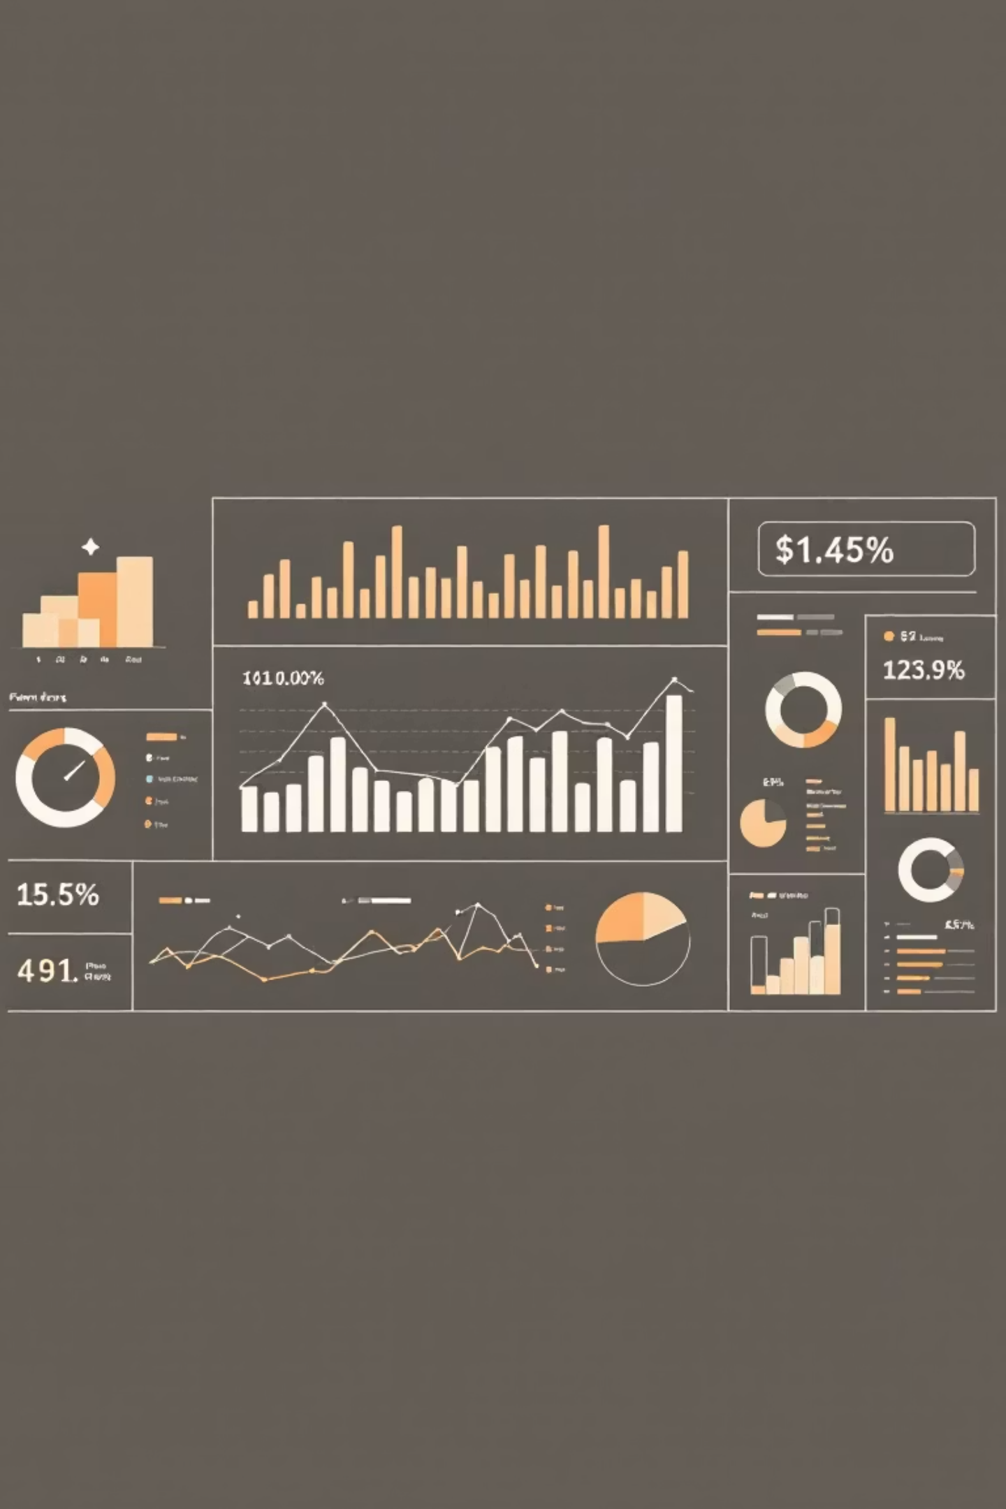
Customer Shopping Behavior Analysis
Analyzing 3,900 purchases to uncover insights into spending patterns, customer segments, and product preferences that drive strategic business decisions.

Slide 2

Dataset Overview
3,900
18
50
Total Purchases
Data Features
Locations
Comprehensive transaction records analyzed
Customer demographics, purchase details, and behavior metrics
Geographic diversity across customer base
$59.76
Average Purchase
Mean transaction value across all categories

Slide 3

Data Preparation & Analysis
01
02
Data Loading & Exploration
Data Cleaning
Imported dataset using pandas, examined structure with df.info() and summary statistics
Handled 37 missing Review Rating values using median imputation by product category
03
04
Feature Engineering
Database Integration
Created age_group bins and purchase_frequency_days columns for deeper insights
Connected to PostgreSQL and loaded cleaned data for SQL business analysis

Slide 4
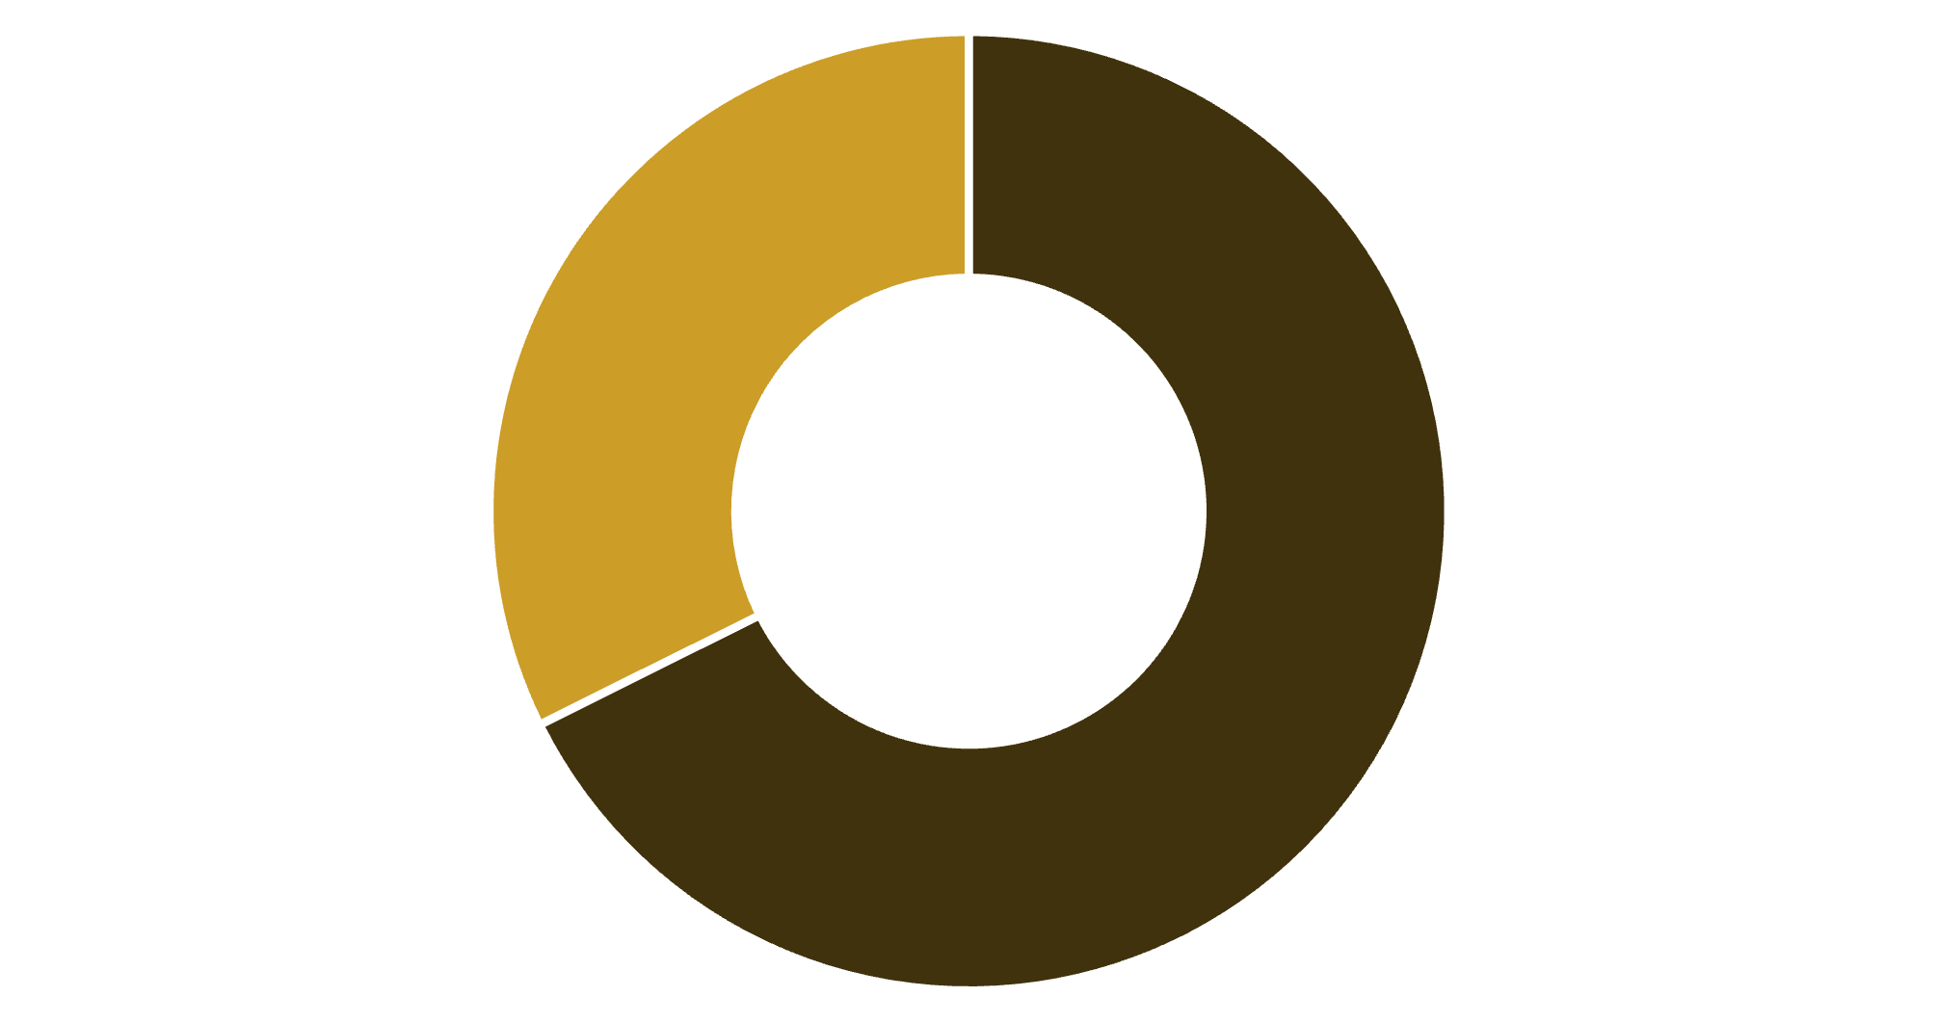
Revenue Insights
Gender Revenue Split
Revenue by Age Group
Young Adult: $62,143
Middle-aged: $59,197
Adult: $55,978
Senior: $55,763
Young adults lead revenue generation, presenting key targeting opportunities.
Male
Female
Male customers generate 68% of total revenue, significantly outpacing female customers at 32%.

Slide 5
Product Performance Analysis
Top Rated: Gloves
Sandals
Boots
3.86 average rating
3.84 average rating
3.82 average rating
Discount-Dependent Products
Shipping Preferences
Hat (50% discount rate)
Express: $60.48 avg purchase
Sneakers (49.66%)
Standard: $58.46 avg purchase
Coat (49.07%)
Express shipping customers spend 3.5% more per transaction.
Sweater (48.17%)
Pants (47.37%)

Slide 6





Customer Segmentation
New
1
83 customers
2
Returning
701 customers
3
Loyal
3,116 customers
80% of customers fall into the Loyal segment, demonstrating strong retention. However, only 27% have active subscriptions, revealing untapped potential.
73%
27%
Non-Subscribers
Subscribers
2,847 customers without subscriptions
1,053 customers with active subscriptions

Slide 7
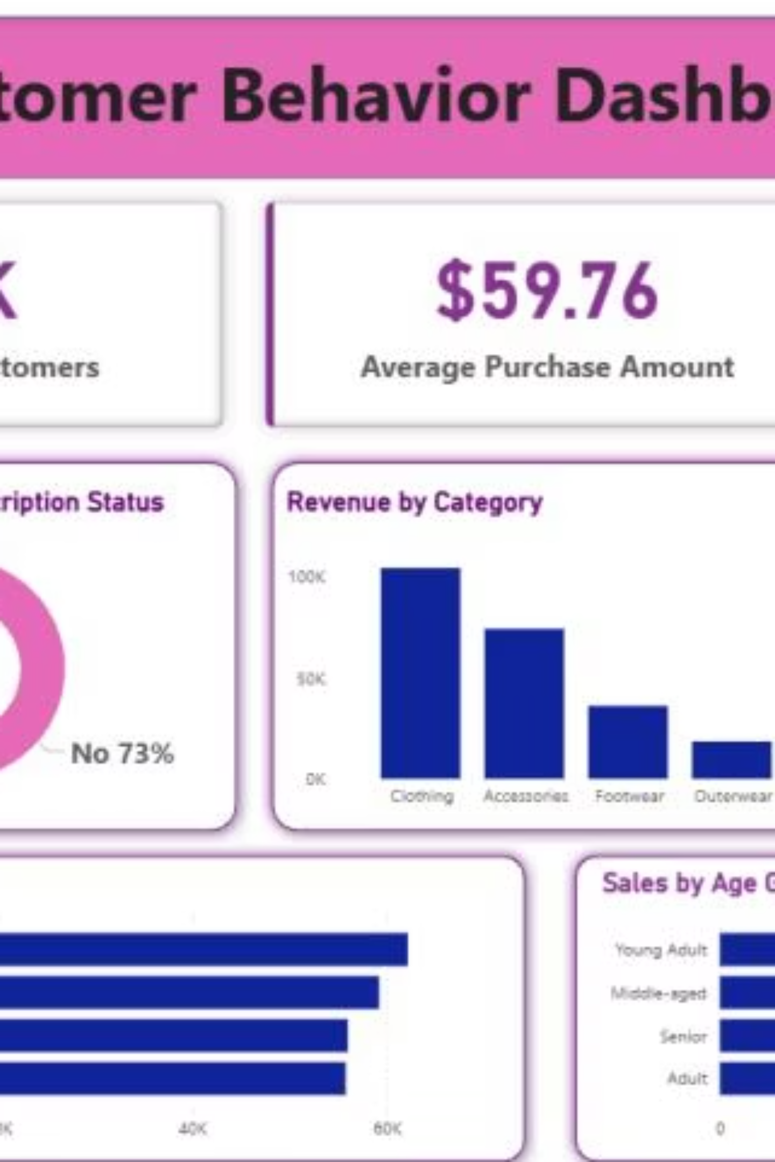
Interactive Dashboard
Power BI dashboard provides real-time insights into customer behavior, revenue trends, and product performance across all segments and categories.

Slide 8


Strategic Recommendations
Boost Subscriptions
Promote exclusive benefits to convert the 73% non-subscriber base into recurring revenue.
Loyalty Programs
Reward repeat buyers to strengthen the already strong 80% loyal customer segment.
Optimize Discounts
Balance promotional sales with margin control, especially for high-discount products.
Targeted Marketing
Focus campaigns on young adults and express-shipping users who generate highest revenue.

